Slide 1

Functional Data Analysis on Monthly Sales
Yingying Yang
STAT 591
April 30,2025

Slide 2
Introduction
Objective:
Analyze and understand temporal sales patterns across different U.S. regions and states using Functional Data Analysis (FDA) techniques.
Goals:
Transform sales time series data into smooth functional representations
Apply B-spline smoothing to monthly sales curves
Perform Functional Principal Component Analysis (FPCA) to extract key variation modes
Use clustering methods to group states with similar sales trajectories
Data Source: (https://www.kaggle.com/datasets/rohitsahoo/sales-forecasting/data)
Superstore Sales dataset from Kaggle, containing:
Order dates
Sales amounts
Region and state information

Slide 3
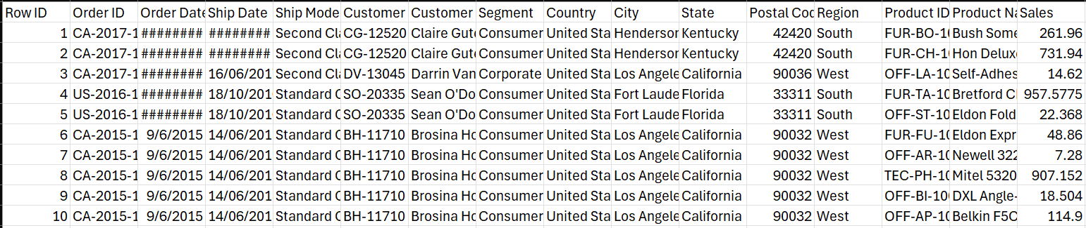
Original Dataset
Total number of orders: 9800
Time range: from 01/2015 to 12/2018
Key variables:
Order Date: Date of transaction
Sales: Sales amount in USD
Region: One of {Central, East, South, West}
State: U.S. state where the sale occurred

Slide 4
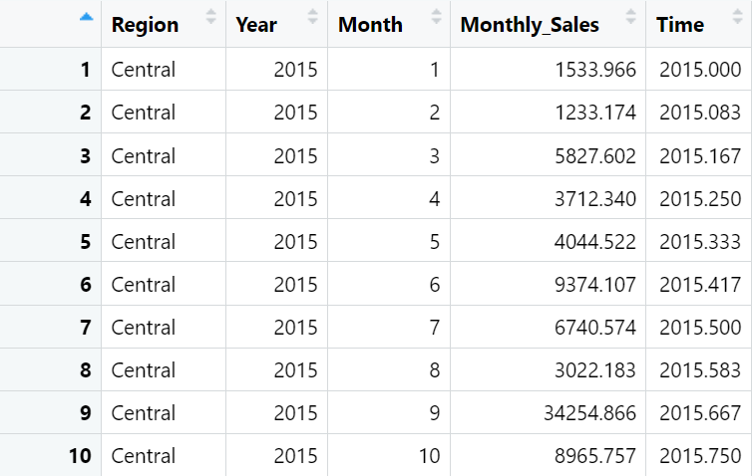
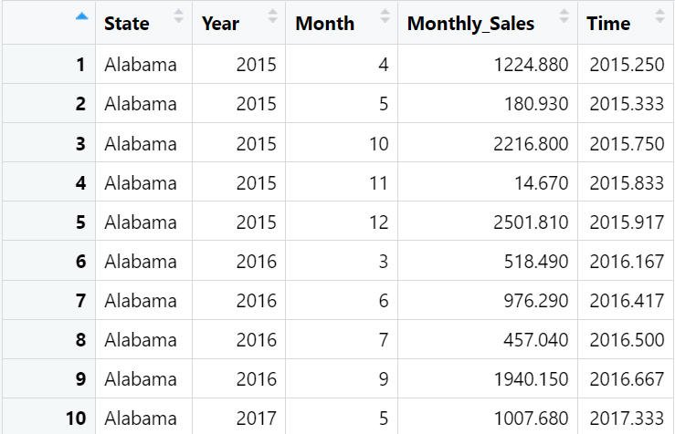
Data Preprocessing
Prepared two datasets: one aggregated by region, the other by state.
For each dataset, monthly sales were aggregated for each region or state.
Filtered out states with fewer than 5 months of available data to ensure reliability.
Created a numeric time variable using year and month, e.g., 2015.000, 2016.667.

Slide 5
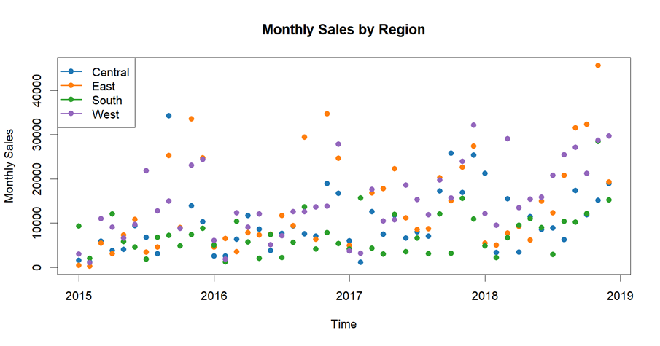
Regional Sales Patterns
Sales data plotted over time for each of the four regions
Noticeable upward trends, especially after 2017
Clear regional differences in sales levels and variability
Scatter plot of monthly sales by region (2015–2019):
Notes:
Observations: West and East regions tend to have higher monthly sales
South region exhibits the lowest overall sales
Fluctuations suggest need for smoothing to reveal underlying trends

Slide 6
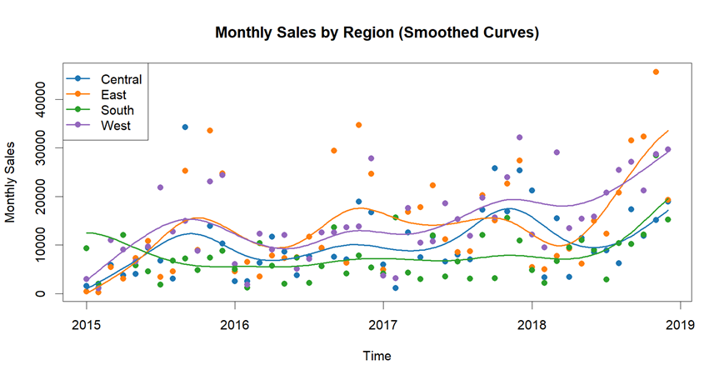
Smoothing of Regional Sales Trends
Applied B-spline basis smoothing to monthly sales curves for each region.
Used cross-validation to select the optimal number of basis functions for each region (n = 14).
Employed a regularization parameter (λ = 0.8) to control the trade-off between smoothness and fidelity.
Visualization shows consistent seasonal and structural patterns across regions.

Slide 7
Smoothing of Regional Sales Trends
East and West regions show a consistent upward sales trend, especially after 2017
Central region shows moderate growth with some seasonal patterns
South remains relatively flat with lower sales overall

Slide 8
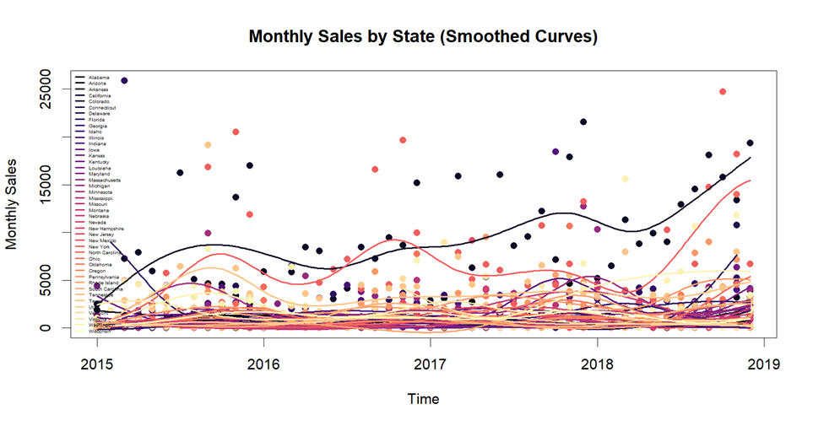
State-Level Smoothed Sales
Substantial variability in sales trajectories across states.
A few states (e.g., California, New York) exhibit strong upward trends, suggesting robust market growth. Most states show relatively flat or mildly increasing patterns.
Clear structural patterns visible in higher-sales states, while others remain noisy or stagnant.
Potential regional clusters are hinted at, motivating further functional clustering.

Slide 9
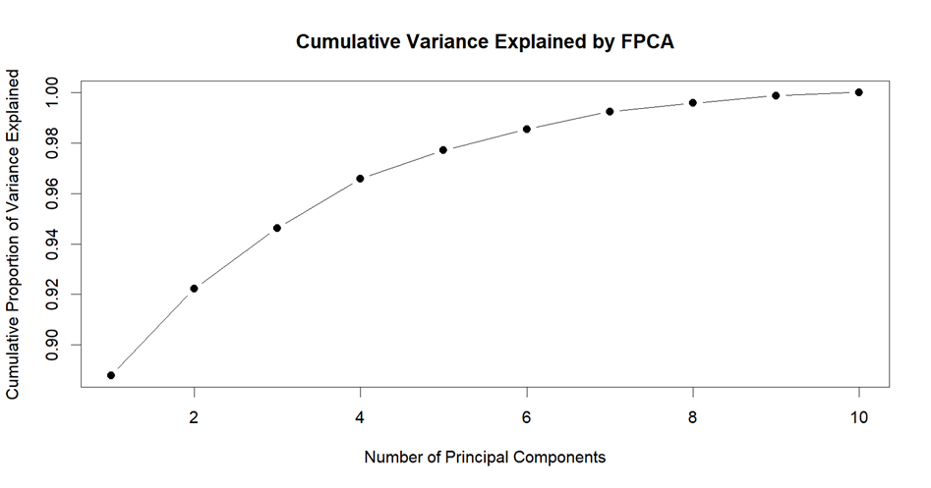
fPCA
Applied FPCA to state-level smoothed sales curves
Used B-spline smoothing to represent each curve in a functional space
Selected 4 principal components, capturing over 95% of total variance
Reduced 49-dimensional functional curves to a 4-dimensional representation

Slide 10
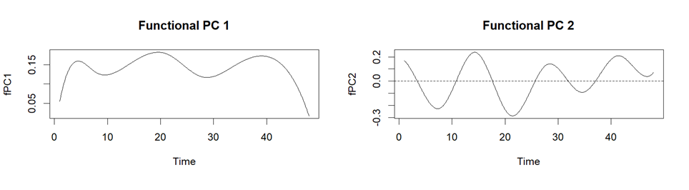
fPCA
Functional PC 1
Pattern: Broadly positive curve with two large humps around time points 10 and 30
Explanation: fPC1 captures the overall average sales trend
Functional PC 2
Pattern: Oscillating curve with alternating positive and negative peaks
Explanation: fPC2 reflects seasonal or cyclical fluctuations in sales

Slide 11
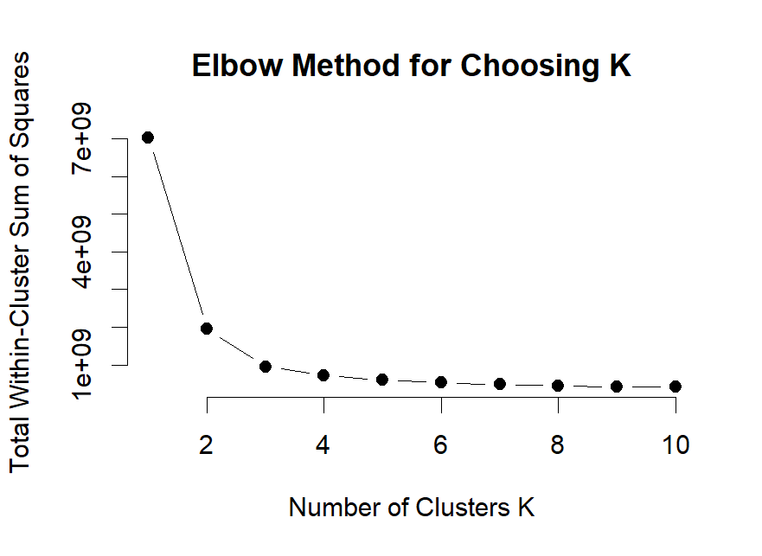
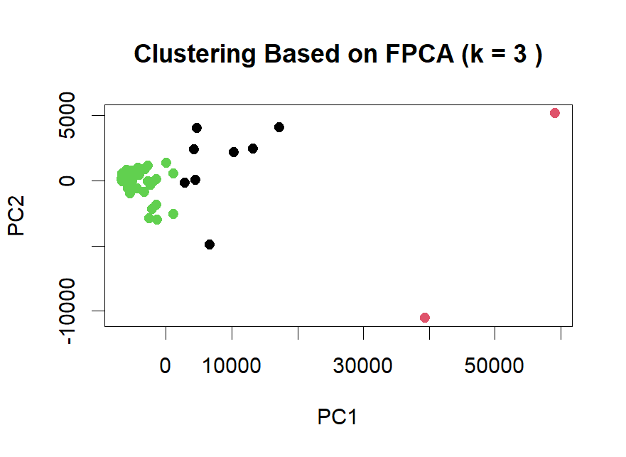
Clustering States Using fPCA
Identified distinct patterns among states based on functional features using fPCA scores.
Applied K-means clustering on the first 4 fPCA scores and selected k = 3 via the Elbow Method.
Three clusters clearly emerged, showing that FPCA preserves key variation while enabling effective dimensionality reduction.

Slide 12
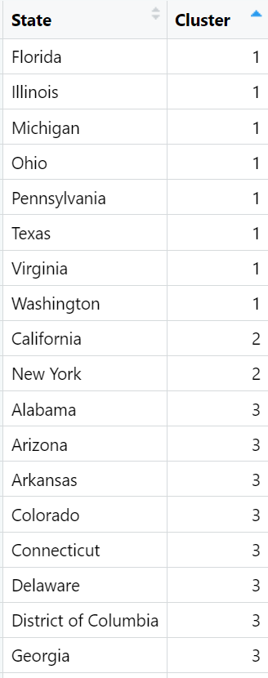
Clustering States Using fPCA
Cluster Summary
Cluster 1: 9 states (e.g., Florida, Illinois, Michigan)
Cluster 2: 2 states (California, New York)
Cluster 3: 38 states (majority of the U.S.)
Key Insights
Cluster 3 dominates, indicating a large group of states share similar functional profiles
Cluster 1 contains diverse states both geographically and demographically, potentially representing a unique usage or policy pattern
Cluster 2, consisting of California and New York, may reflect distinct large-state behaviors that differ significantly from the rest

Slide 13


Thank You

